Slide 1
v.0.0.1

Slide 2


[Put your Photo Here]
Welcome! My name is
Kyle
1
I’m here to lead this session & help you learn something new today!
2
I’m a Junior at UCSC.
3
My favorite programming technology is Amazon Web Services.
Notes:
What to Edit:
Add your name, photo, school info, and favorite programming tool or language.
What to Do:
Make attendees feel welcome by running a short Ice Breaker.
Go around the room and ask each person to answer the following questions:
Who are you?
What year are you in school and what is your major/field of study?
What is your favorite programming language or tool?
You should go first to demonstrate the exercise and introduce yourself

Slide 3
1
Using your Web Browser,
Open this URL & Fill out the Form:
http://mlhlocal.host/checkin
2
Afterwards, Check your Email to Find:
Setup Instructions
An Invite to the MLH Slack
The Code Samples
A Workshop FAQ
These Workshop Slides
More Learning Resources
Notes:
What to Say:
Tell attendees we are going to check them in for the event
Once attendees check-in, they will receive an email with the items listed on the slide
Attendees must check-in to get credit for attending this event
What to Do:
Confirm that everyone has checked in by asking participants to give you a signal when they receive the email.

Slide 4

Our Mission is to Empower Hackers.
65,000+
HACKERS
12,000+
PROJECTS CREATED
400+
CITIES
We hope you learn something awesome today!
Find more resources: http://mlh.io/
Notes:
What to Say:
Major League Hacking (MLH) events are meant to bring hackers together so they can learn, build, and share.
Give participants a brief overview of Major League Hacking (MLH).
Tell participants they can learn more at http://mlh.io/
Example Talking Points:
TODO
Through Localhost MLH is rethinking technology education to reflect how hackers actually learn and how fast the industry moves.
Here’s some quick facts about MLH:
Each year, MLH supports over 65,000 hackers around the world at events they facilitate
Those students create more than 12,000 amazing projects together
MLH is a global organization that empowers hackers in more than 400 cities and growing every day

Slide 5
What will you learn today?
1
Structure and Syntax of HTML and CSS
2
Important HTML Elements and CSS Properties
3
How to Deploy Your Website
Notes:
What to Say:
Explain to participants what they will learn today
Learning is a core part of being a hacker and today they are going to learn something new
What to Do:
Get participants excited about the experience.

Slide 6
Why does this matter?
1
HTML and CSS are used in every website!
2
HTML and CSS are the foundation of more complicated skills you may learn later.
3
Being able to deploy and share your personal website helps you market yourself and connect with other developers!
Notes:
What to Say:
Explain to participants what they will learn today
Learning is a core part of being a hacker and today they are going to learn something new
What to Do:
Get participants excited about the experience.

Slide 8
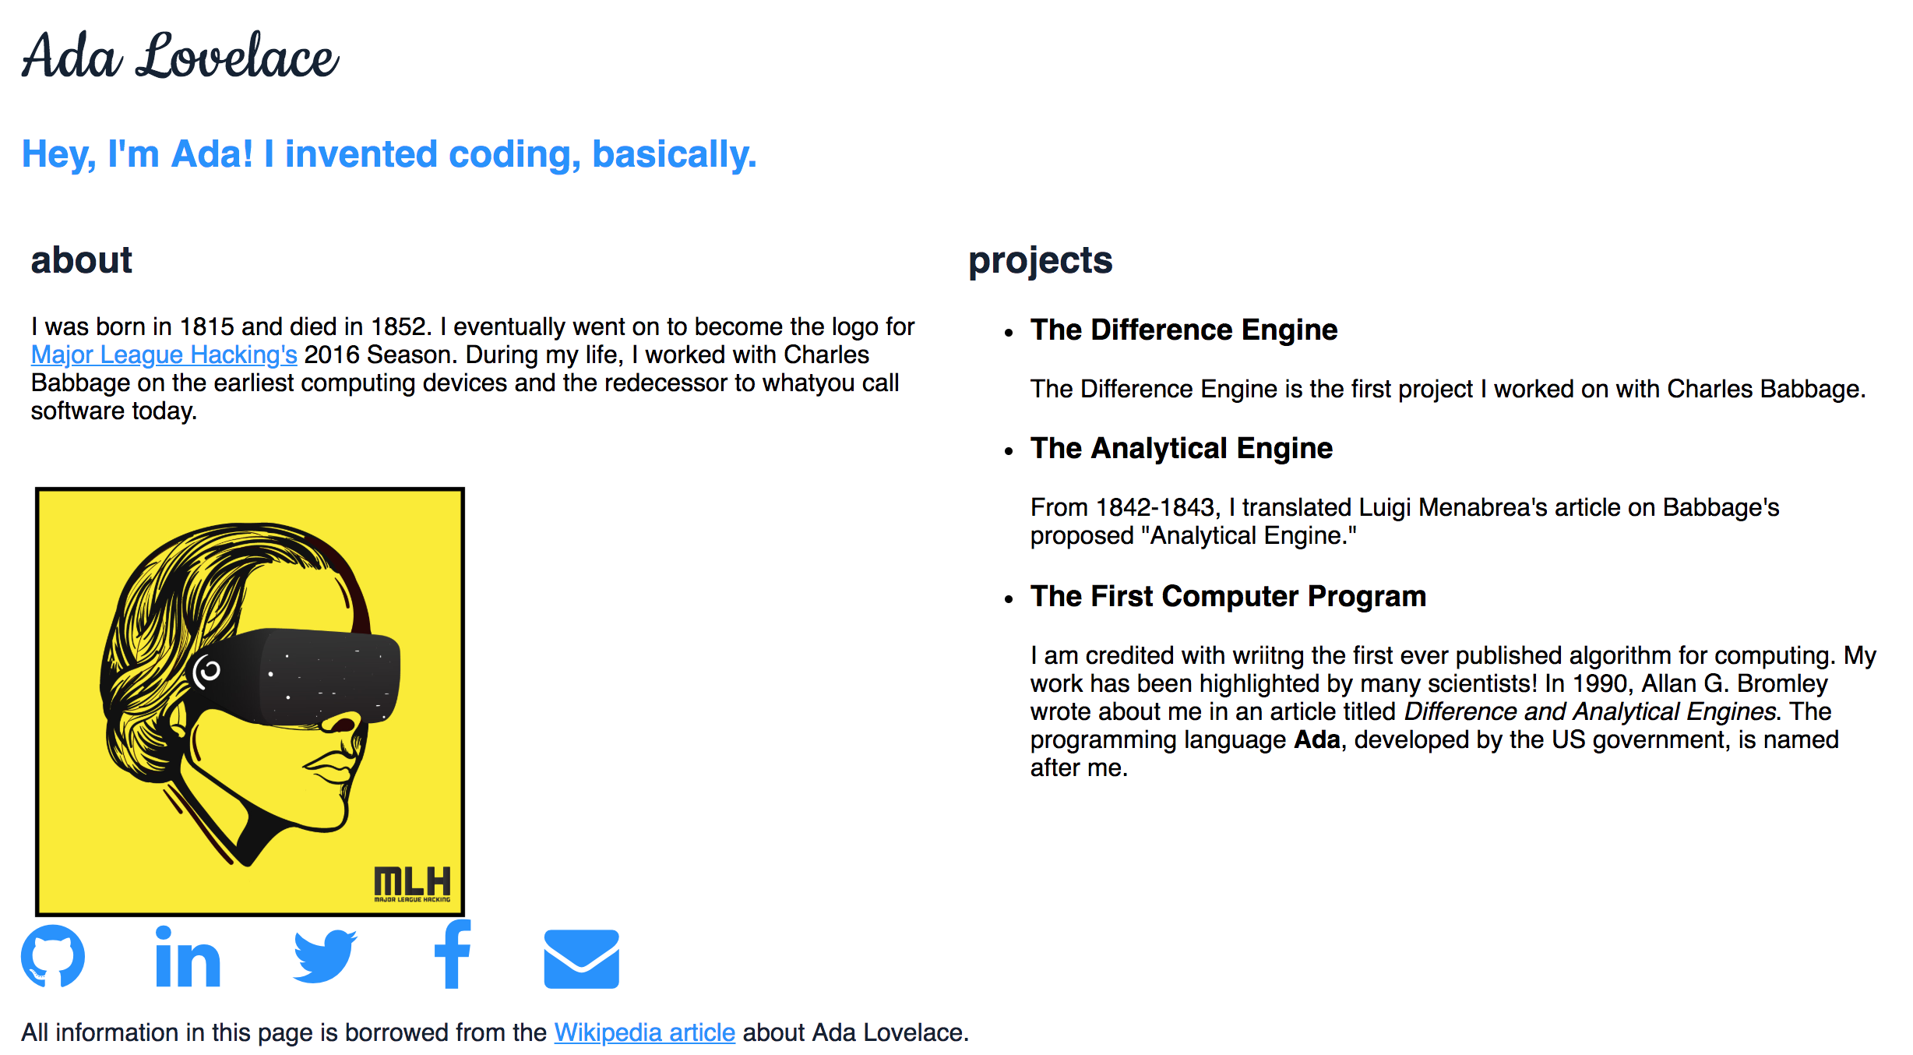
What are we building today?
To preview the what you'll be building, go to this URL:
mlhlocal.host/first-website
Notes:
What to Say:
Today, we're going to build a simple, standard, personal webpage.
It's really important to know that you can change anything about the website we're building today.
For example, if you don't have "personal," "school," and "hackathon" projects, you can change these to link to your instagram, your blog, a paper you've published, or anything else!
You can also feel free to change the colors, images, fonts, etc.
Today's workshop is meant to dip your toes into the word of simple website development.
What to Do:
Wait a moment while everyone pulls up the webpage.

Slide 9
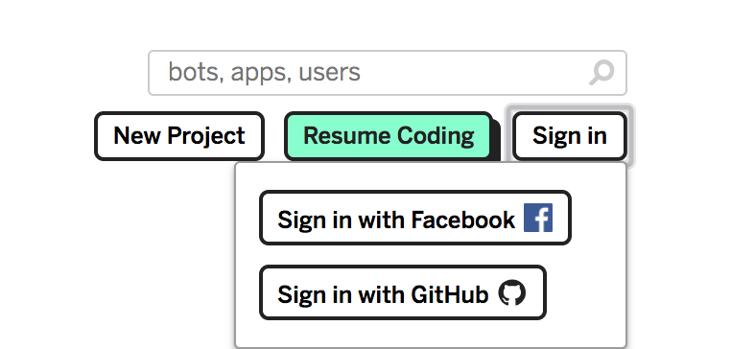
Make an Account on Glitch
Go to Glitch.com
In the upper right hand corner, click Sign in
Select Sign in with Facebook or Sign in with GitHub.
Notes:
What to Say:
You can complete these commands in Mac Terminal or Windows PowerShell
What to Do:
Make sure everyone has opened the code in a text editor - wait for others to catch up if necessary.

Slide 10
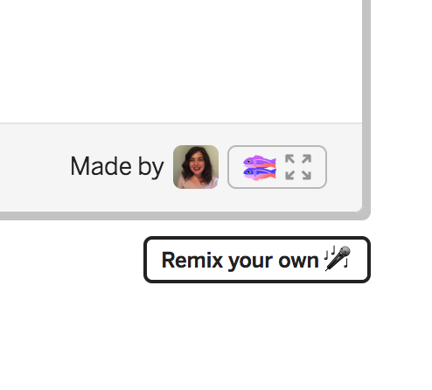
Remix the Starter Code
Go to mlhlocal.host/first-website-remix.
Scroll down.
Click Remix your own.
Notes:
What to Say:
You can complete these commands in Mac Terminal or Windows PowerShell
What to Do:
Make sure everyone has opened the code in a text editor - wait for others to catch up if necessary.

Slide 11
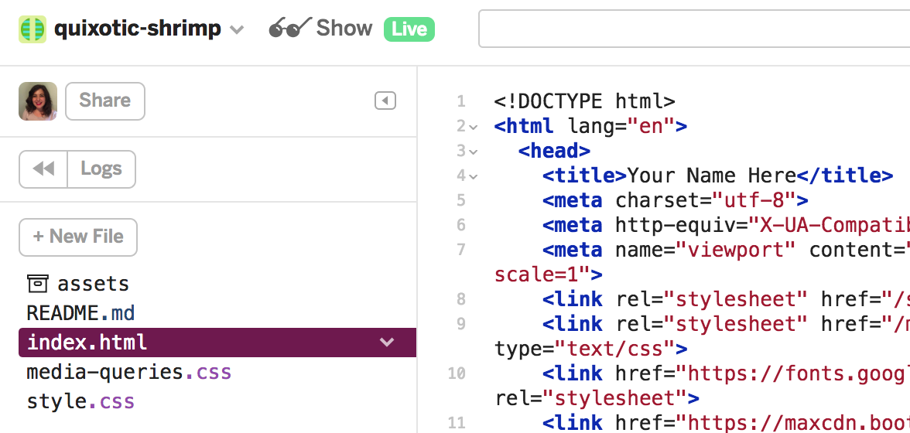
Preview the Website
Click Show Live. The website will open in another tab.
Notes:
What to Say:
What to Do:

Slide 12
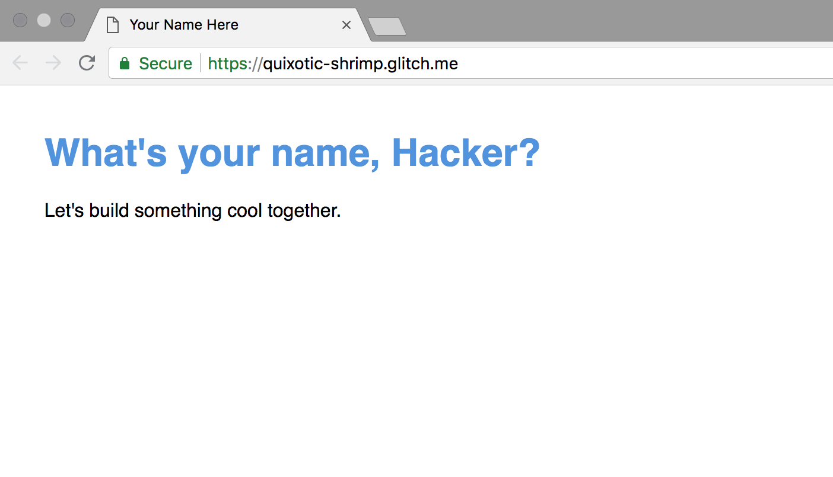
Preview the Website
This is what your website looks like right now. Let's change it!
Notes:
What to Say:
What to Do:

Slide 13
Make Your First Changes
In the tab with your code, replace Your Name Here (line 4) and What's your name, Hacker? (line 15) with your name.
Check the tab with the live version to see the changes!
Notes:
What to Say:
What to Do:

Slide 14
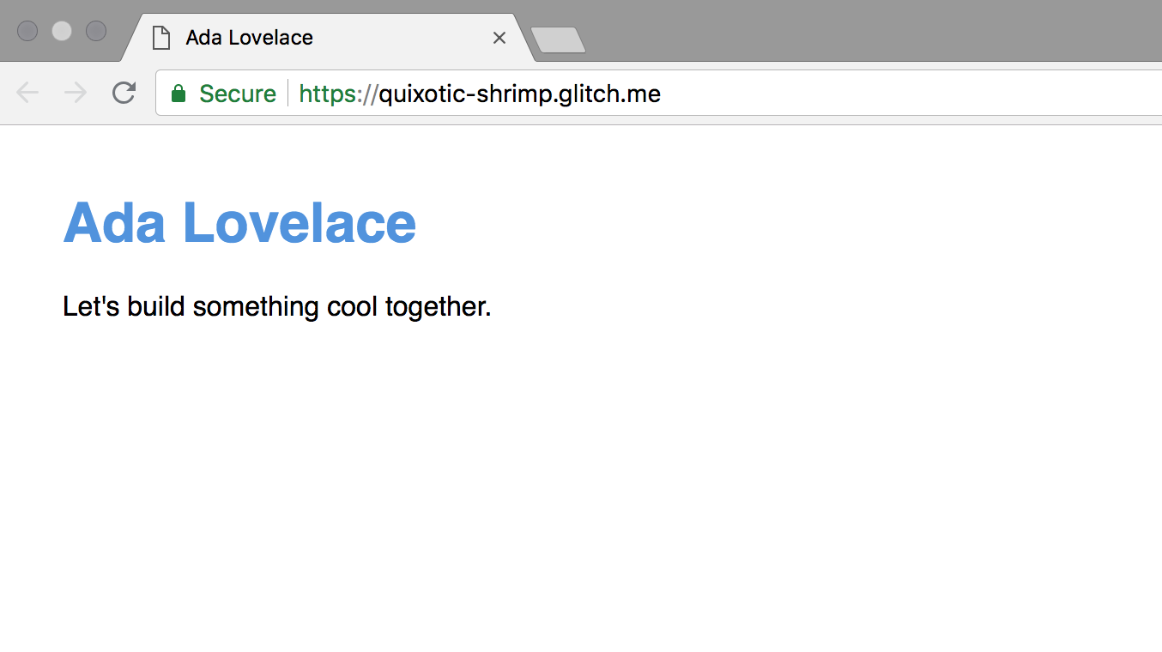
Preview Your First Changes
Make sure the website says your name, not Ada Lovelace!
Notes:
What to Say:
What to Do:

Slide 15
That was pretty cool! We edited the HTML and saw live changes on our website. Let's dive into the project to understand what we just did!

Slide 16
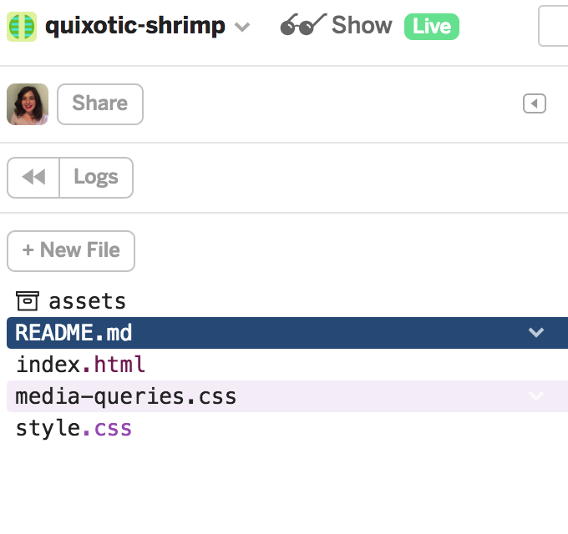
What are all these files?
assets/ – a folder where you can store images you want on your page
README.md – information about your website
index.html – the skeleton of your website
Notes:
What to Say:
What to Do:

Slide 17
What are all these files?
media-queries.css – a file that makes your website look nice on different devices (you won't be editing that file in this workshop)
style.css – a file that contains the main styling for your website (you will be editing this file)
Notes:
What to Say:
What to Do:

Slide 18
What is HTML?
HTML is the skeleton of every webpage on the internet.
Key Term
HTML (hypertext markup language): HTML is the code that structures webpages.
1
2
3
4
5
6
7
8
9
10
11
<!DOCTYPE html> <html>
<head> <meta charset="utf-8"> <title>Title of Your Website</title> </head> <body> // Body Content </body> </html>
Notes:
What to Say:
What to Do:

Slide 19
HTML Syntax
Most HTML elements consist of an opening tag, content, and a closing tag. Important exceptions include the <link> and <img> tags, which are called "self-closing" tags.
<body> /* Content */ </body>
Opening Tag Content Closing Tag
Notes:
What to Say:
Now that we're going to be adding some HTML and CSS to this web page, let's make sure that we understand how all of it works.
What to Do:

Slide 20
Every website needs the code below
What does this code mean?
Line 1: Specifies that the code below is HTML.
Line 2: This is an opening <html> tag.
Line 3: The <head> tag contains information about your website. This isn't visible to users.
1
2
3
4
5
6
7
8
9
10
11
<!DOCTYPE html> <html>
<head> <meta charset="utf-8"> <title>Title of Your Website</title> </head> <body> // Body Content </body> </html>
Notes:
What to Say:
What to Do:

Slide 21
Every website needs the code below
What does this code mean?
Line 5: This is the title of your website that users see in the browser tab
Line 6: This is a closing </head> tag. This ends element.
Line 7-10: This is the <body> of your website.
Line 11: This tag closes your <html> element.
1
2
3
4
5
6
7
8
9
10
11
<!DOCTYPE html> <html>
<head> <meta charset="utf-8"> <title>Title of Your Website</title> </head> <body> // Body Content </body> </html>
Notes:
What to Say:
What to Do:

Slide 22
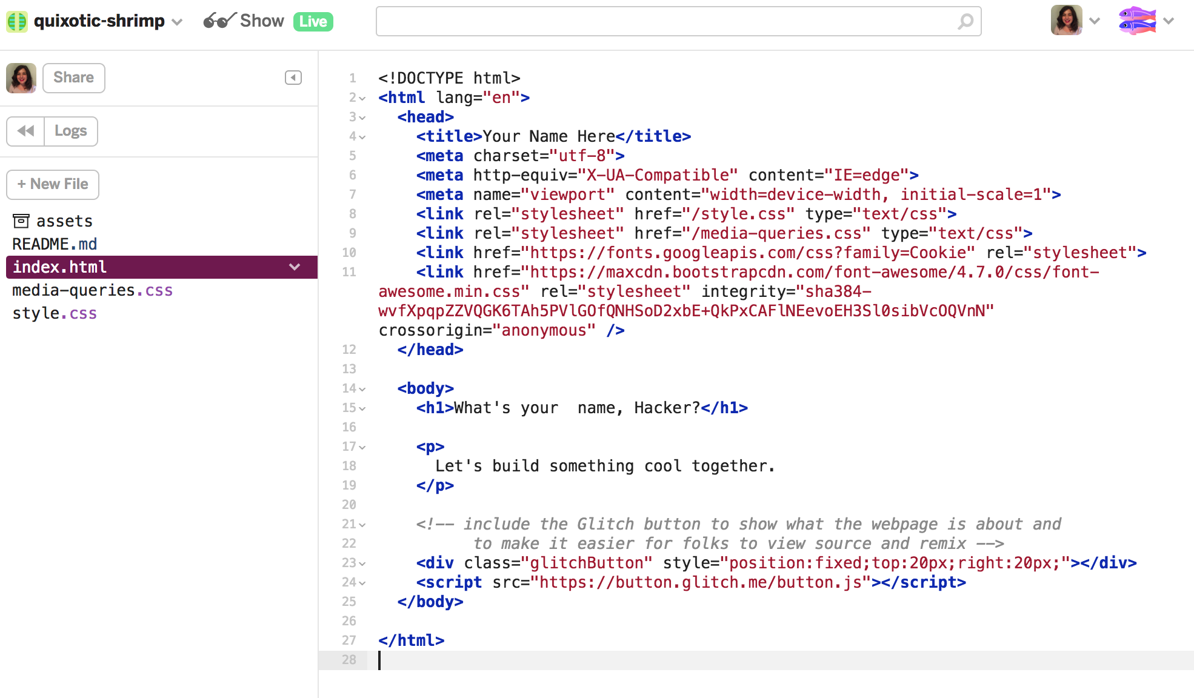
What’s in our HTML?
Open index.html in Glitch.
Notes:
What to Say:
What to Do:

Slide 23
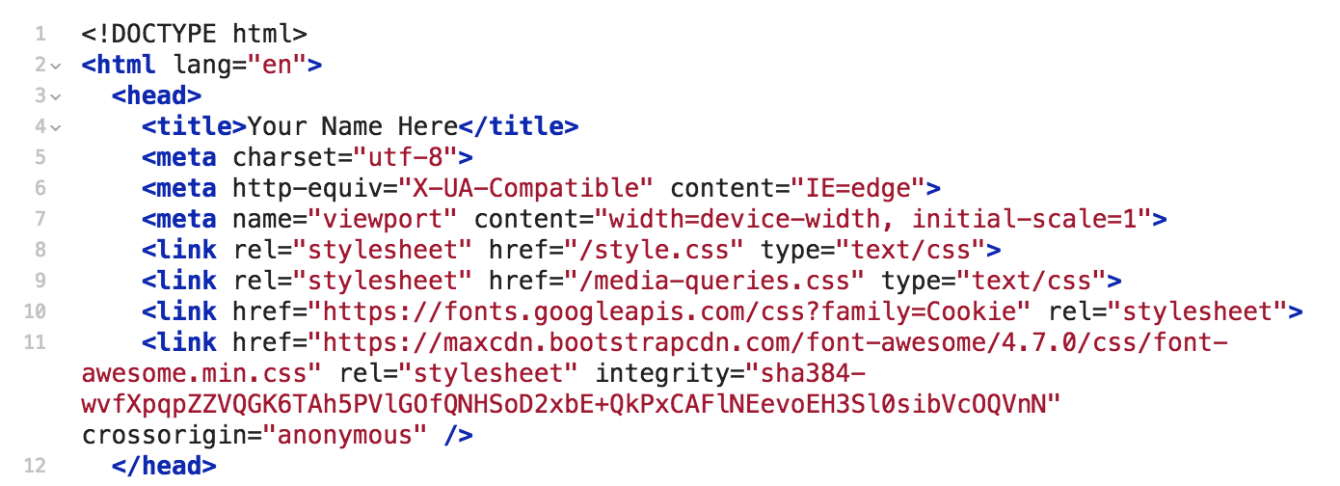
index.html I
What does this code mean?
Line 5-7: <meta> tags contain information about how the page should be rendered.
Notes:
What to Say:
What to Do:

Slide 24
index.html II
What does this code mean?
Line 8-11: <Link> tags connect your HTML to other files. Our HTML is connected to two files that we have in our project:
style.css – our main stylesheet
media-queries.css – the stylesheet that makes our web page look nice on various devices
Notes:
What to Say:
What to Do:

Slide 25
index.html III
What does this code mean?
Line 8-11: <Link> tags connect your HTML to other files. Our HTML is connected to two files that we don't have in our project from:
fonts.googleapis.com, which allows us to add fonts to our website
maxcdn.bootstrapdcdn.com, which allows us to use an icon library called Font Awesome to add icons to our page
Notes:
What to Say:
What to Do:

Slide 26
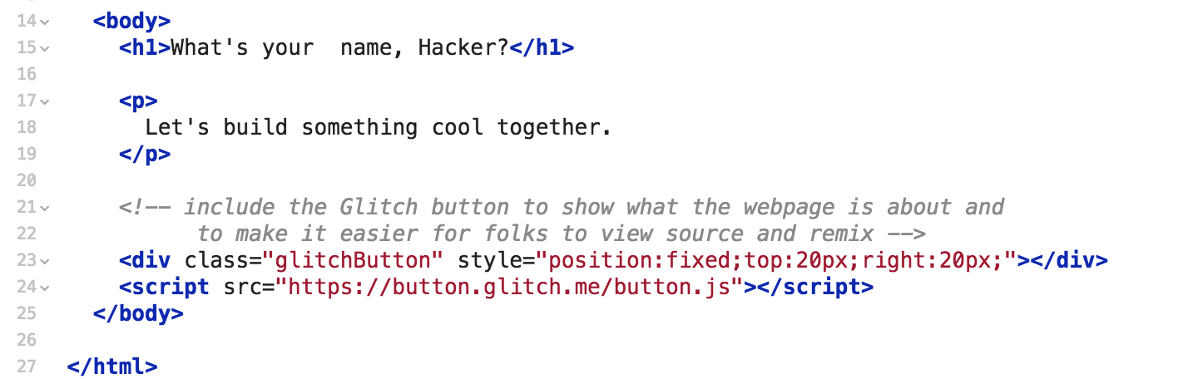
index.html IV
What does this code mean?
Line 14 - 25: All of the visible content of our website is between the opening and closing <body> tags.
<h1> is a header tag. These range from <h1> to <h6>.
<p> is a paragraph tag.
Lines 23-24 make the Glitch fish appear in the corner.
Notes:
What to Say:
What to Do:

Slide 27
That was a deep dive into index.html. Remember, HTML is the skeleton of your web page. Some of the text on our page is blue, and some of it is bigger than other parts.
How do we style HTML elements?

Slide 28
Using CSS!
Open style.css in Glitch and let's dive in!

Slide 29
CSS Syntax
This is a CSS Rule Set.
The selector specifies which elements to style.
A property is a characteristic of an element we can set.
A value is how that property should appear.
h1 {
color: blue;
}
Selector
Property
Value
Notes:
What to Say:
What to Do:

Slide 30
CSS Syntax
This is a CSS Rule Set.
A value and a property together are a declaration
A selector and its declarations together make a rule set
h1 {
color: blue;
}
Rule Set
Declaration
Notes:
What to Say:
What to Do:

Slide 31
Now that you understand the structure and syntax of HTML and CSS, let's add some content to your website.

Slide 33
Add a Headline
Change Let's build something cool together (line 18) to a sentence or two about yourself.
Notes:
What to Say:
What to Do:

Slide 34
Add the About Section I
Add an <h2> element that says about on line 21.
Add a <p> element on line 25. Add some information about yourself.
Notes:
What to Say:
What to Do:

Slide 35
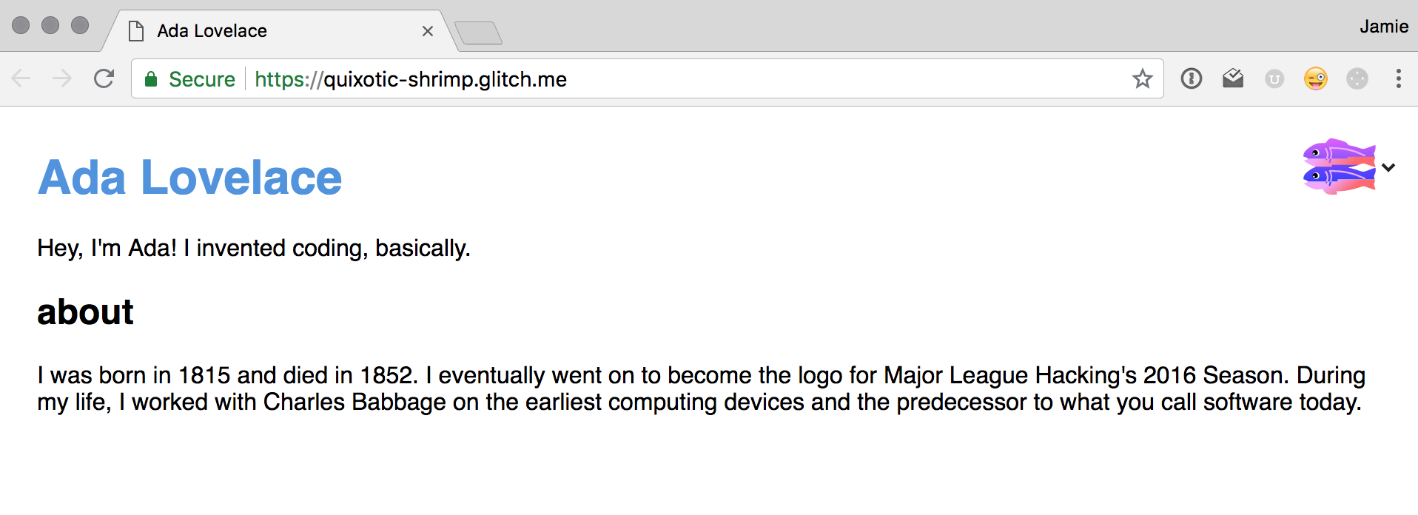
Add the About Section II
Look at the live version again! It should look like this.
Notes:
What to Say:
What to Do:

Slide 36

Code Review
<h2> – a heading element. These range from <h1> to <h6>. Every web page should only have one <h1>. It is a best practice to think of them like roman numerals in an outline, used to separate levels of detail.
<p> – a paragraph element. These are used to create paragraphs of text on your web page.
Notes:
What to Say:
What to Do:

Slide 37
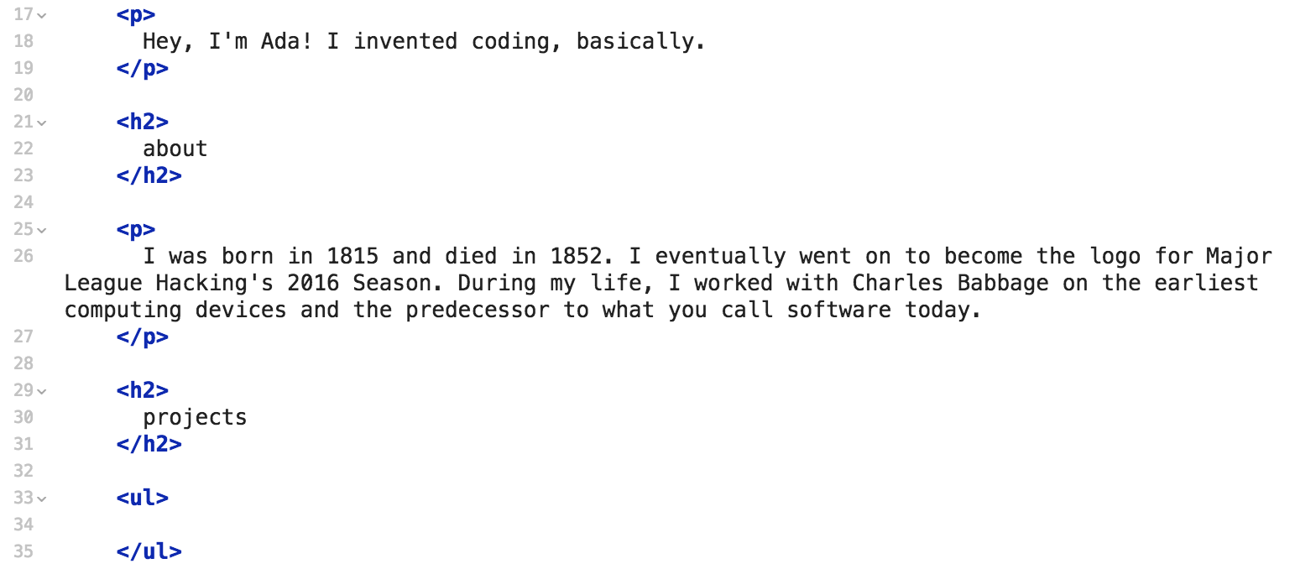
Add the Projects Section I
Add an <h2> element that says projects on line 29.
Add a <ul> element on line 33. Leave it empty for now.
Notes:
What to Say:
What to Do:

Slide 38
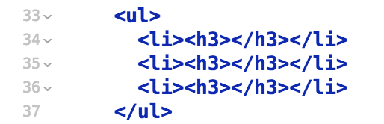
Add the Projects Section II
Inside the <ul> element, add 3 <li> elements.
Inside each <li> element, add an <h3> element.
Note: Glitch will separate <h3> elements onto three lines. We have deleted the blank space between the opening and closing tags of the <h3> elements.
Notes:
What to Say:
What to Do:

Slide 39
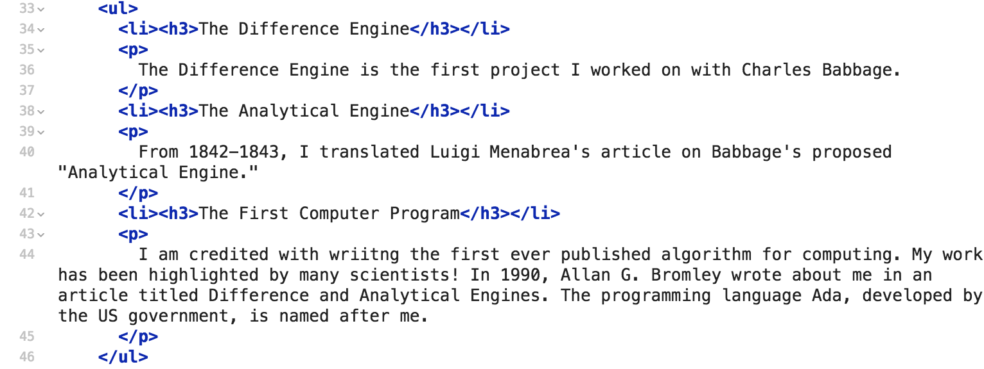
Add the Projects Section III
Inside each <h3> element, list a project or accomplishment you'd like to highlight.
Below each <li> element, add a <p> of text to describe the project.
Notes:
What to Say:
What to Do:

Slide 40
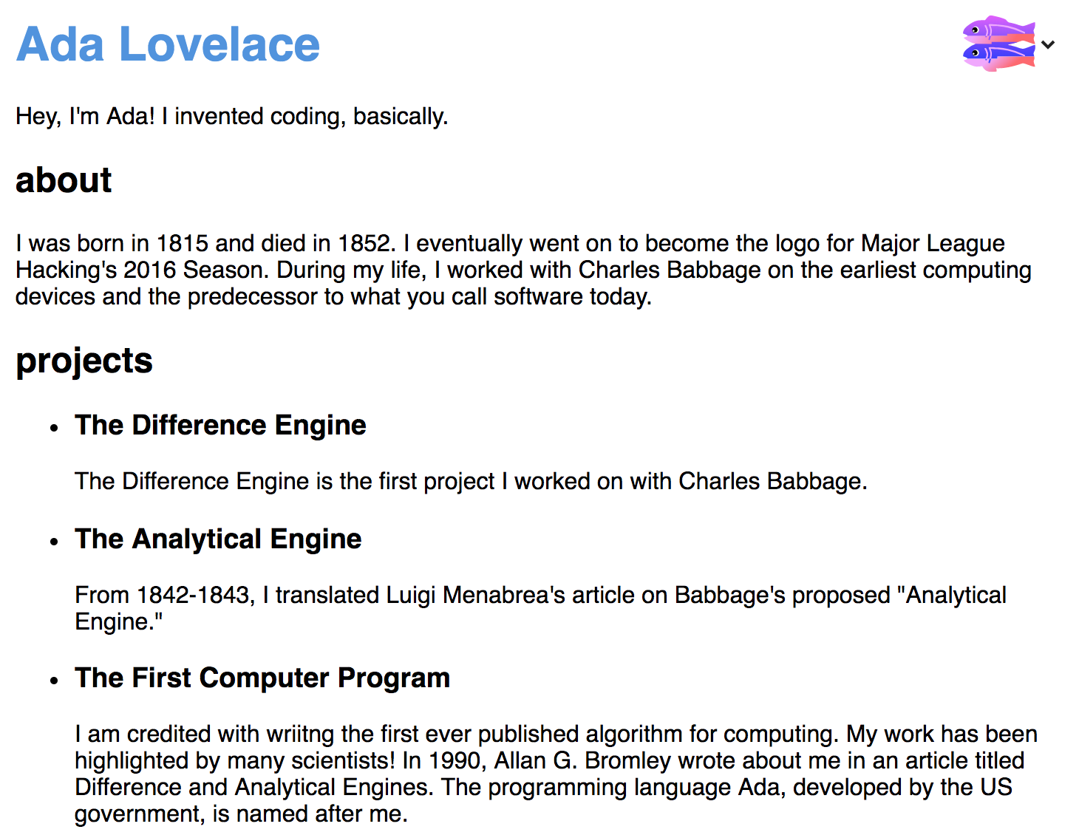
Add the Projects Section IV
Look at the live version again! It should look like this.
Notes:
What to Say:
What to Do:

Slide 41

Code Review
<ul> – an unordered list. By default, an unordered list element will contain a bulleted list of elements.
<li> – a list item. Inside of <ul> and <ol> (ordered lists) elements, each item you want to include should be contained inside its own <li> element.
Notes:
What to Say:
What to Do:

Slide 42
Elements Can Be Nested
HTML elements that are inside of other HTML elements are called child elements. The outer element is the parent element. <li> elements are children of <ul> elements and <ol> elements.
<ul> <li>Item Number One</li> </ul>
Begin Parent Element Child Element End Parent Element
Notes:
What to Say:
Elements can be nested inside of other nested elements, like grandchildren and great-grandchildren.
What to Do:

Slide 43
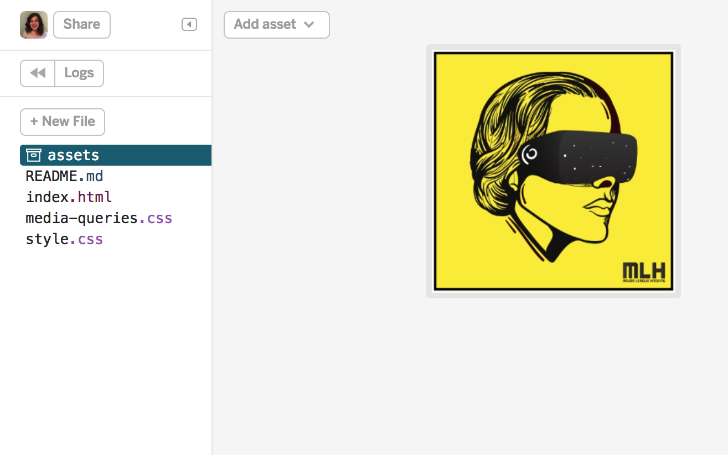
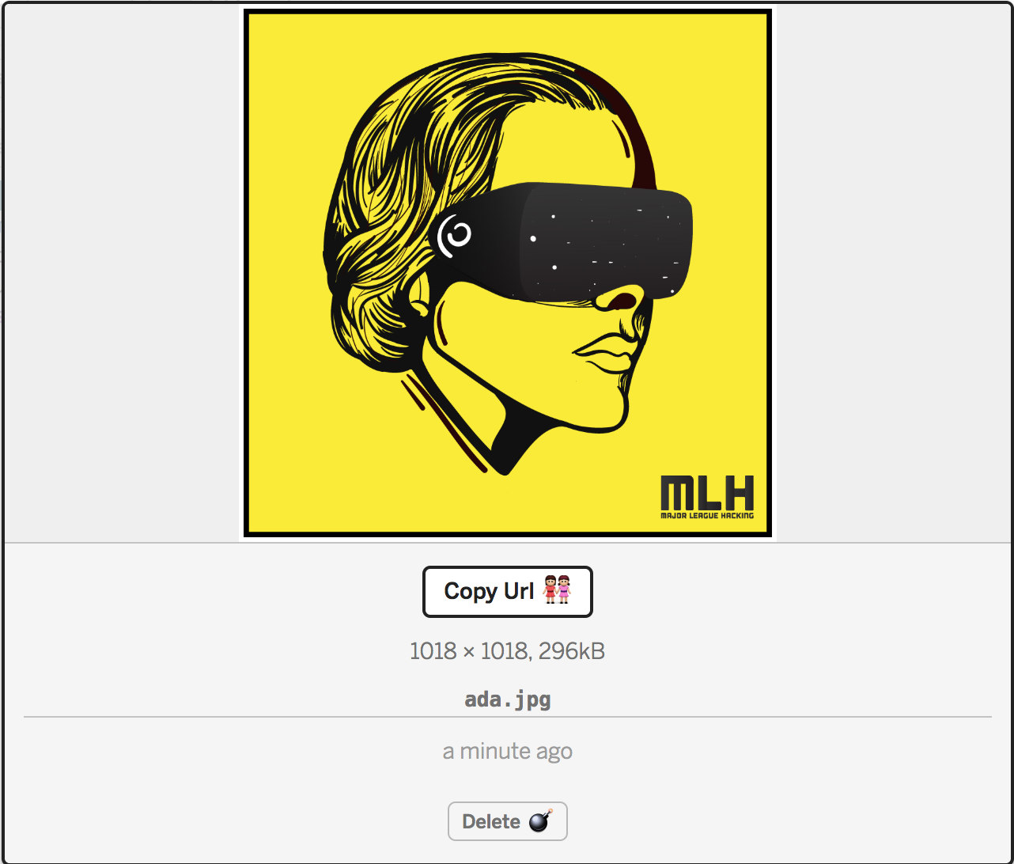
Add an Image I
Add an image of yourself to the assets/ folder in Glitch. You can just drag and drop the image here!
Click the image, then click Copy Url.
Notes:
What to Say:
What to Do:

Slide 44
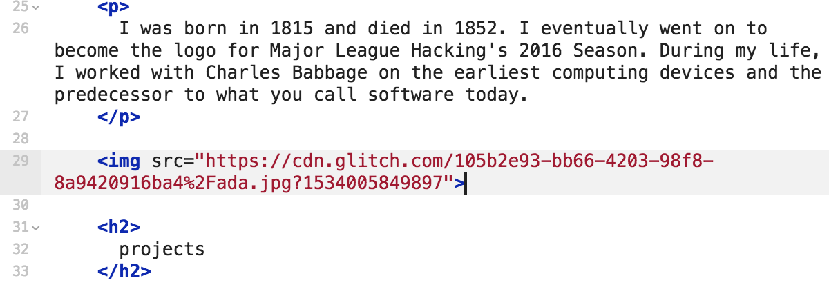
Add an Image II
Return to index.html. Below the about paragraph, add an <img> tag.
Inside the <img> tag, add a src attribute. Set src= the URL you copied in the last slide. The URL needs to be surrounded by quotation marks.
Notes:
What to Say:
What to Do:

Slide 45
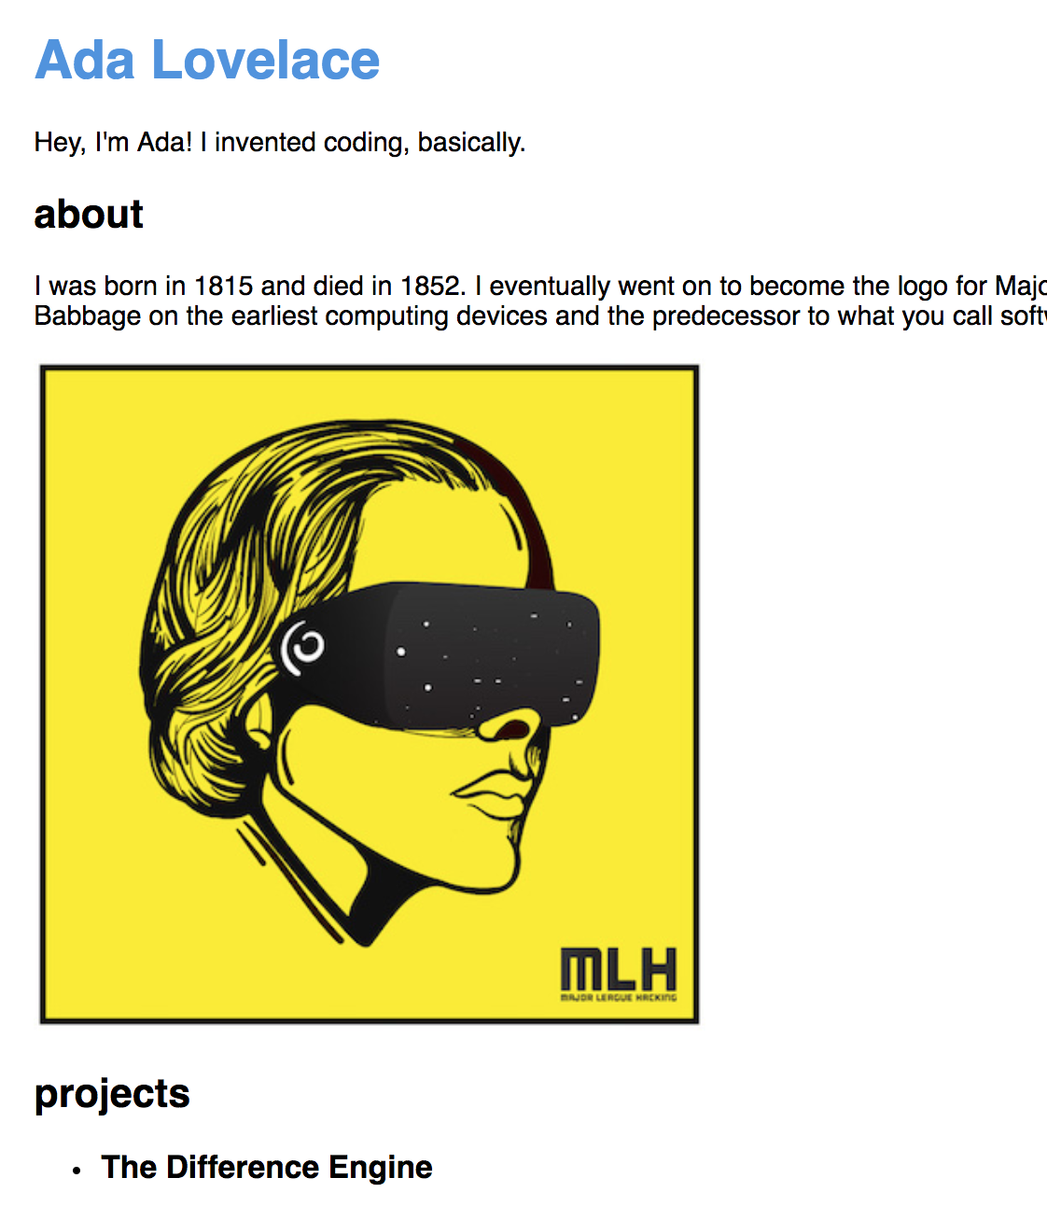
Add an Image III
Look at the live version again! It should look like this. Note: Your image might be huge. We'll fix this later.
Notes:
What to Say:
What to Do:

Slide 46
Code Review
<img> – an element that contains an image. <img> is a self-closing tag. This means you do not need to write it like <img></img>.
src – an attribute. All <img> elements require the src attribute, which tells the browser where the image is stored.
Key Term
Attribute: Something you can add to HTML elements that modifies them in some way.
Key Term
Self-closing tag: HTML tags that do not require an opening and closing tag.
Notes:
What to Say:
What to Do:

Slide 47

Add a Contact Section I
We want to add Contact Icons at the bottom of the page.
Notes:
What to Say:
What to Do:

Slide 48
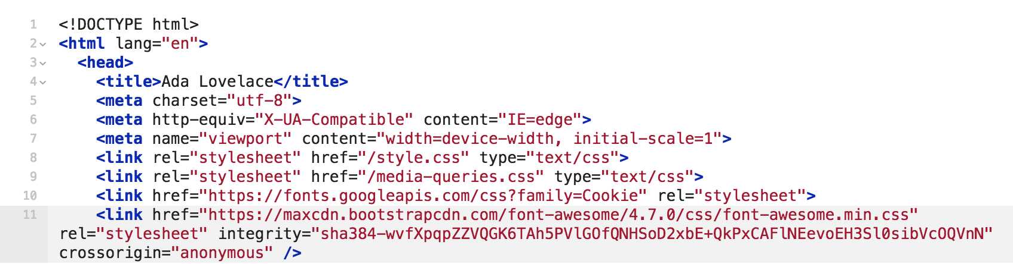
Add a Contact Section II
Remember when we reviewed the <link> tags at the beginning of the workshop? Look at or around line 11. This <link> tag allows us to use icons from Font Awesome, a library of icons. Check out Fontawesome.com! The first icon we're going to add will link to your LinkedIn.
Notes:
What to Say:
What to Do:

Slide 49
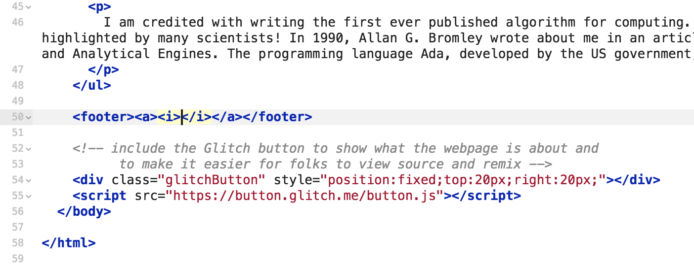
Add a Contact Section III
Return to index.html. Below the closing </ul> tag, add a <footer> element.
Inside the <footer> element, add an <a> tag.
Inside the <a> element, add an <i> tag.
Notes:
What to Say:
What to Do:

Slide 51
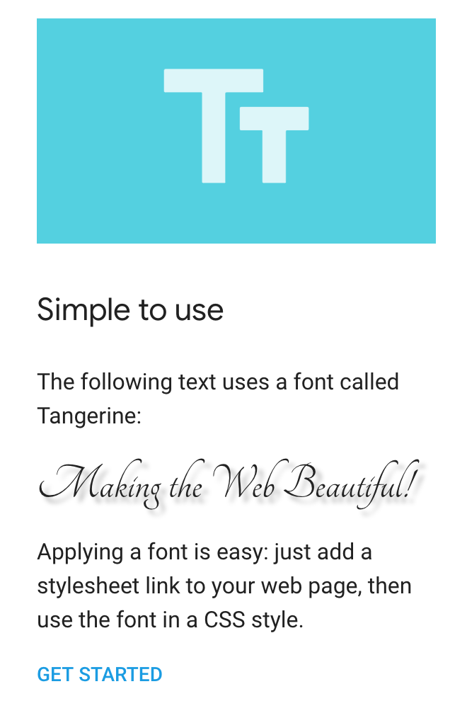
Optional Customization III
Visit fonts.google.com and learn how to add fonts to your webpage. Change the fonts of your name, your headers, or your paragraphs.
Notes:
What to Say:
What to Do:

Slide 52
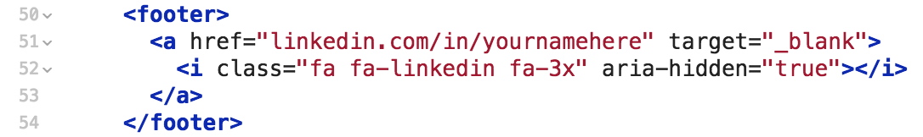
Add a Contact Section IV
Add an href attribute inside of the opening <a> tag. Set it equal to the URL of your LinkedIn profile.
Add target="_blank" inside the opening <a> tag as well.
Add the following code inside of the opening <i> tag: class="fa fa-linkedin fa-3x" aria-hidden="true"
Note: Your code does not need to be separated this way. We added new lines for readability.
Notes:
What to Say:
What to Do:

Slide 53
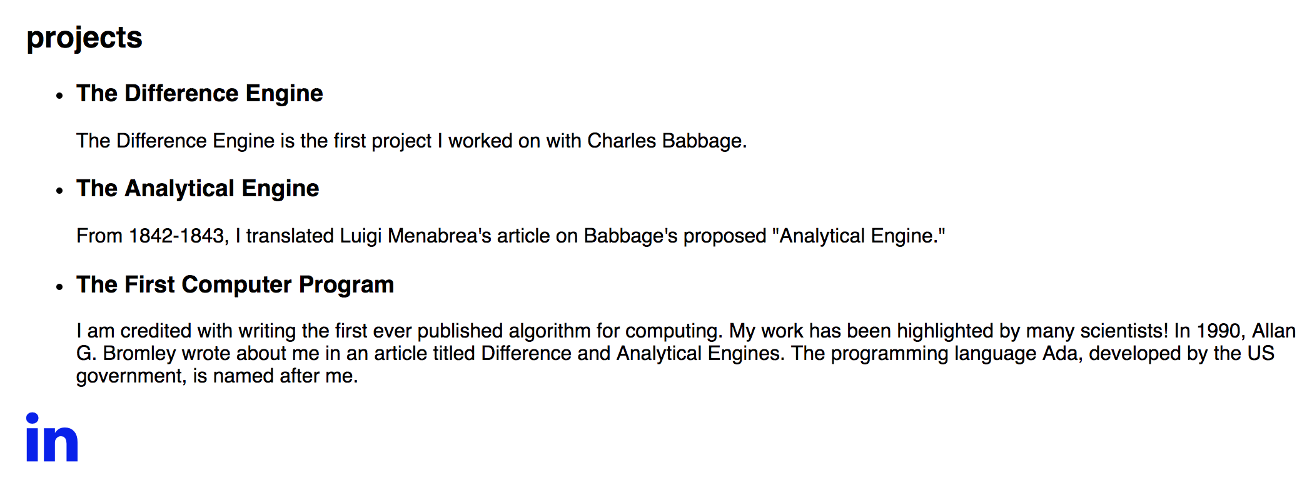
Add a Contact Section V
Look at the live version again!
The bottom of your page should look like this! Later, you can add all the icons you want by checking the Font Awesome documentation for instructions.
Notes:
What to Say:
What to Do:

Slide 54
Code Review
<a> - an anchor element. These are used to create links on your page.
<i> - an element with several uses; in this case, to add icons to your web site.
href - an attribute that contains the URL an <a> element should link to.
target - an attribute that you can use to open links in new tabs
class - an attribute that is used to group elements; when writing CSS, you can apply specific styles to all elements that you give the same class
aria-hidden - an attribute that tells a screen reader to ignore an element
Notes:
What to Say:
What to Do:

Slide 55
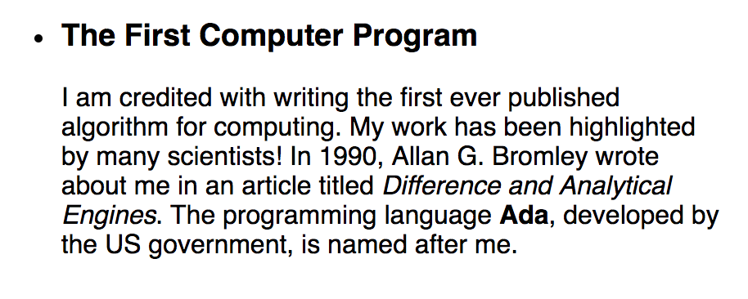
Add Text Elements I
To make texts italics or bold, we can use two elements: <em> and <strong>
Notes:
What to Say:
What to Do:

Slide 56
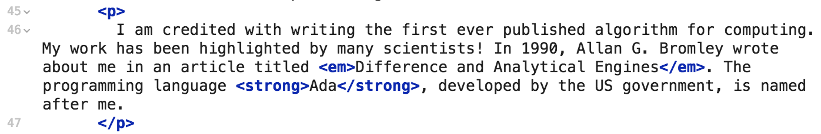
Add Text Elements II
Return to index.html. Add opening and closing <em> tags around something you would like in italics. This can be any text element!
Add opening and closing <strong> tags around something you want to be bold.
Notes:
What to Say:
What to Do:

Slide 57
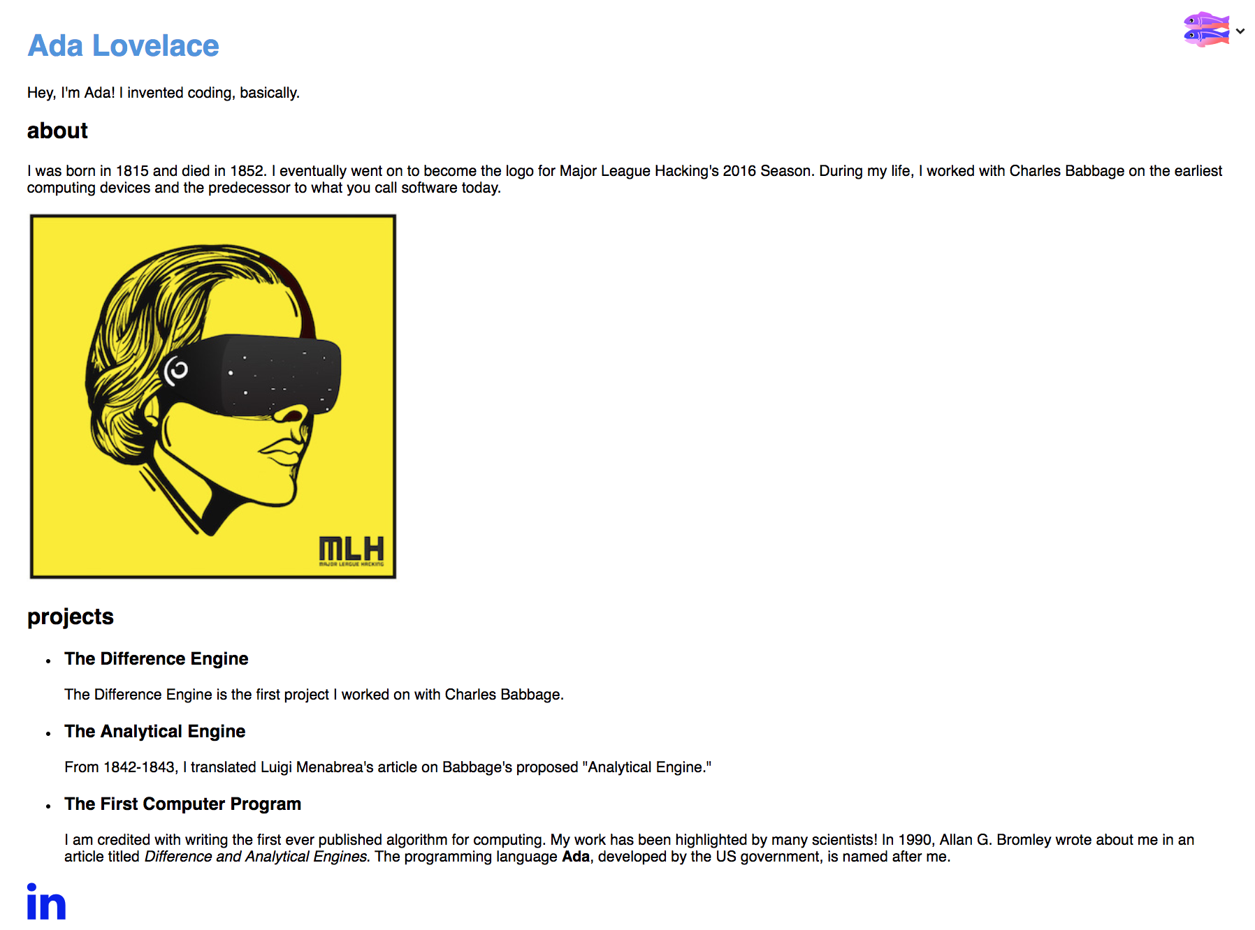
Add Text Elements III
Look at the live version again!
Everyone's will be different, depending on where you added the <em> and <strong> tags. However, this is what our page looks like at this point:
Notes:
What to Say:
What to Do:

Slide 58
We've added all (or most!) of the content we want. Now, let's work on styling our website!

Slide 60
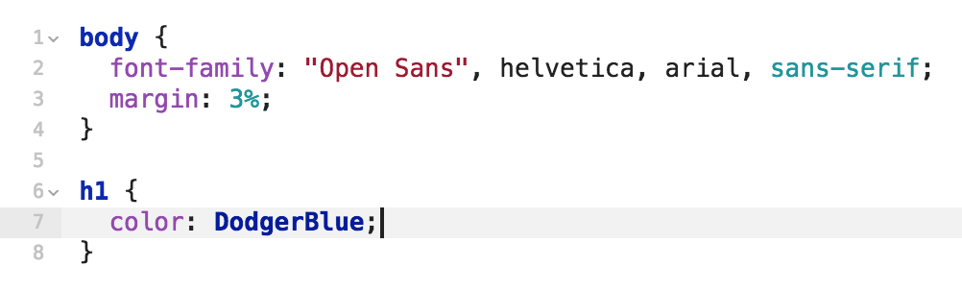
style.css I
What does this code mean?
Line 1: body is a css selector. The code from line 1-4 will be applied to the entire body.
Line 2: font-family specifies the font. This code says "Use Open Sans" for all the text in the body, and the browser doesn't know Open Sans, use helvetica, arial, or sans-serif.
Notes:
What to Say:
What to Do:

Slide 61
style.css II
What does this code mean?
Line 3: margin means how much space should be around elements. This means to put a 3% margin around all sides of the body. Percent is one way to specify the size of elements; we'll learn more about this in a few slides.
Notes:
What to Say:
What to Do:

Slide 62
style.css III
What does this code mean?
Line 6: h1 is another CSS selector. This means apply all the styles between the opening and closing curly braces {} to all <h1> elements in this web site.
Line 7: color is a CSS property. A property is something about an element that we can style. Line 7 says to make the text of all h1 elements DodgerBlue, which is a color that is built into CSS. There are 147 of these!
Notes:
What to Say:
What to Do:

Slide 63

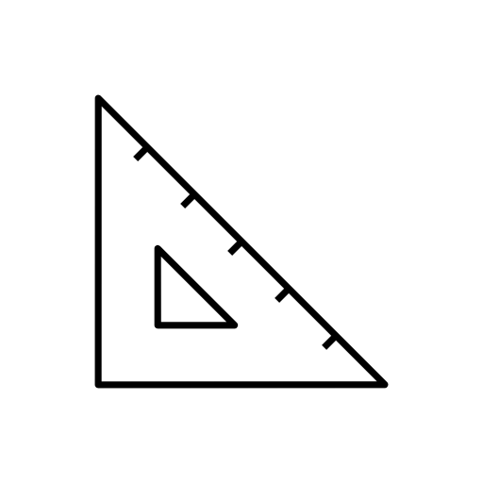
CSS Units in This Project
There are many different CSS sizing units. These are the ones used in this project.
pixels (px)
Absolute sizing of elements.
Example: <h1>, <h2>, <h3>, and <p> elements are sized with pixels in this web page.
Percentages (%)
Relative sizing of elements. Percentages size an element relative to its parent container
Example: the images in the "Projects" section have width: 80% of their containing <div>
viewport width units (vw)
Relative sizing of elements. A vw is 1% of the width of the viewport, which is the part of the browser that contains the web page
viewport height units (vh)
Relative sizing of elements. A vh is 1% of the height of the viewport, which is the part of the browser that contains the web page
Notes:
What to Say:
What to Do:

Slide 64
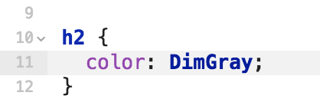
Add Some Color I
Open style.css. Add an h2 CSS rule set below the h1 css rule set.
Inside of this CSS rule set, change the color of h2 elements to anything you want! Check out mlhlocal.host/css-colors for a list!
Notes:
What to Say:
https://htmlcolorcodes.com/color-names/
What to Do:

Slide 65
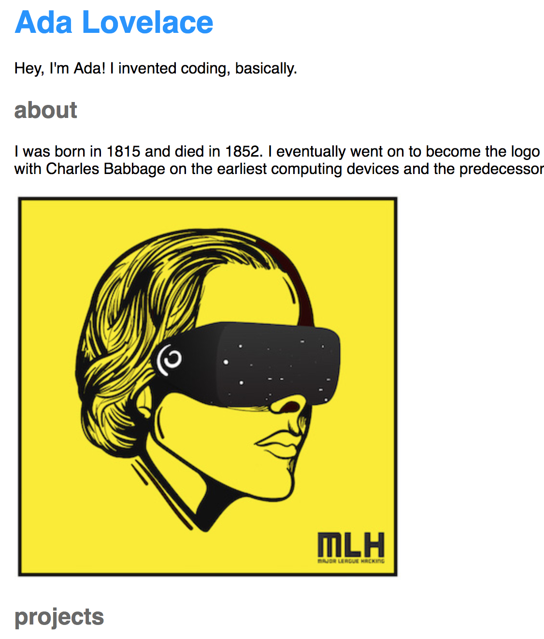
Add Some Color II
Look at the live version again!
Everyone's will be different, but this is what ours looks like after we changed the h2 elements to DimGray.
Notes:
What to Say:
What to Do:

Slide 66
CSS Tag Selectors
In style.css, these styles are applied to all elements inside of the <body> element, which is the whole web page
Key Term
tag selectors: CSS selectors that style all elements with a certain tag
Notes:
What to Say:
What to Do:

Slide 67
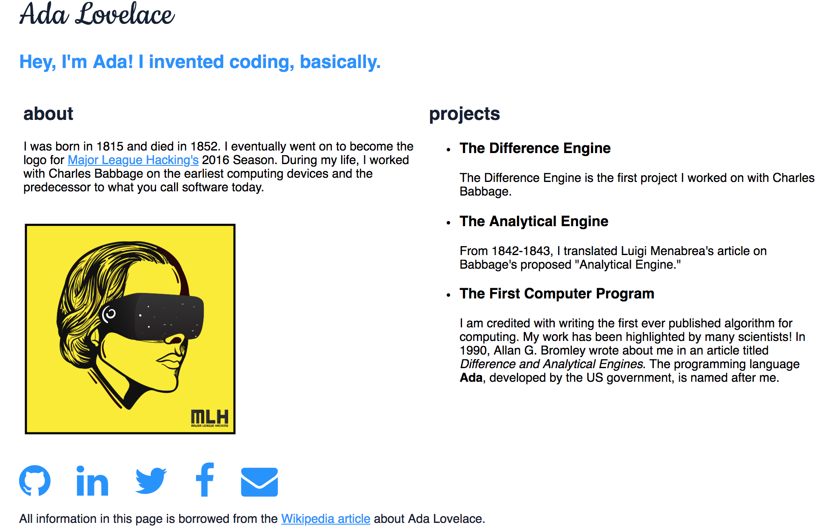
Add Some Structure I
Ada's website has the about section next to the projects section.
Let's do the same to ours!
Notes:
What to Say:
What to Do:

Slide 68
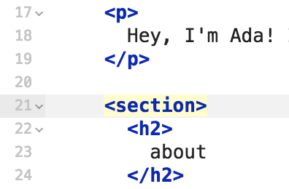
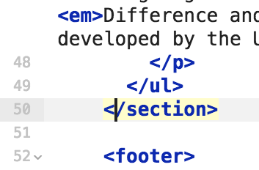
Add Some Structure II
Return to index.html. We're going to add a <section> element. Add the opening <section> tag above the <h2> that says About. Add the closing </section> tag right before the <footer>.
Notes:
What to Say:
What to Do:

Slide 69
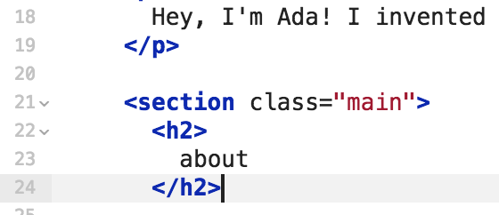
Add Some Structure III
Give the opening <section> tag a class attribute with the value main. This will allow us to style this section later.
Notes:
What to Say:
What to Do:

Slide 70
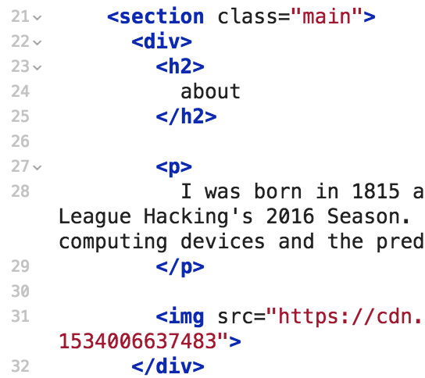
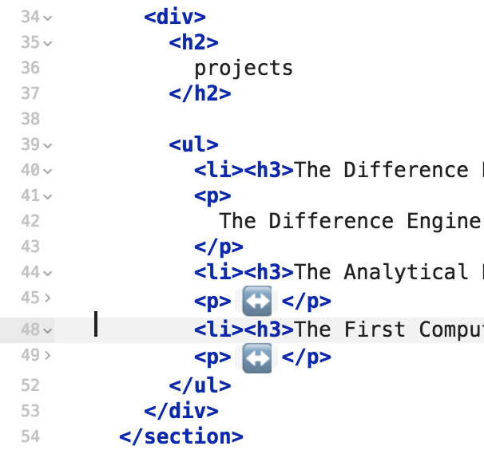
Add Some Structure III
Now add two <div> elements. Put one around the about section. Add the around around the projects section.
Note: We collapsed some of the paragraph elements for readability.
Notes:
What to Say:
What to Do:

Slide 71
Add Some Structure IV
Look at the live version. Nothing has changed yet; <section> and <div> elements are not visible. They group code together so that we can style and position it.
Notes:
What to Say:
What to Do:

Slide 72
CSS Class Selector
In style.css, these styles are applied to all elements that have the "logo" class. Class selectors are more specific than tag selectors, so they will override tag selectors.
Key Term
class selectors: CSS selectors that style all elements with a certain class
13 .logo {
14 text-align: left;
15 width: 48vw;
16 }
Notes:
What to Say:
For example, if the body selector had the declaration: text-align: center;, .logo elements would have left-aligned text.
What to Do:

Slide 73
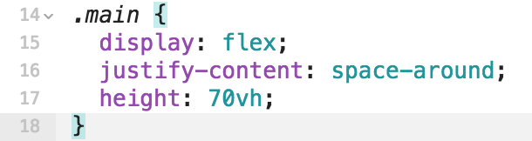
Add Some Structure V
Return to style.css. Add a CSS rule set that will style elements with the class main.
Add the following code inside of that rule set.
Notes:
What to Say:
What to Do:

Slide 74
Code Review
display – a CSS property that determines how an element should take up space on a page
flex – one possible value for the display property. Usually, each HTML element is displayed on its own line. When using flex, each element squeezes next to the one before it.
justify-content - a CSS property tells the browser how much space should be between elements on the same line
space-around - a value for the justify-content property that puts equal space around all elements
Notes:
What to Say:
What to Do:

Slide 75
Code Review
height – a CSS property that specifies how tall an element should be
70 vh – vh means view height. 70 view height means 70% of how tall the user's browser window is. This means: "Make the main section of this website 70% as tall as the user's browser."
Notes:
What to Say:
What to Do:

Slide 76
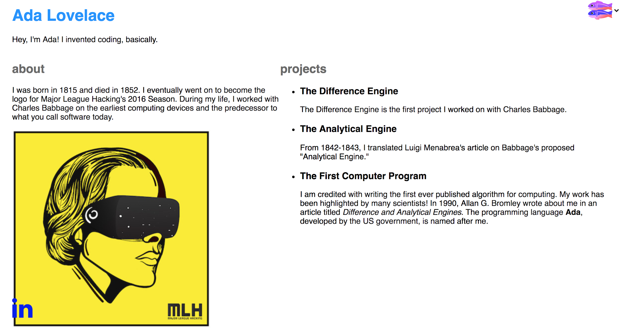
Add Some Structure VI
Look at your page again!
We want to set the dimensions of the left and right sections next.
Notes:
What to Say:
What to Do:

Slide 77
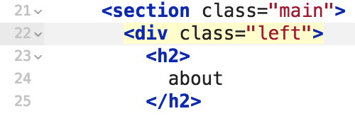
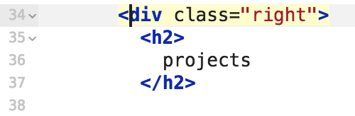
Add Some Structure VII
Return to index.html. Add the class "left" to the div around the about section. Add the class "right" to the div around the projects section. This will allow us to style them.
Notes:
What to Say:
What to Do:

Slide 78
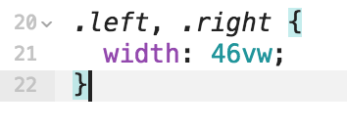
Add Some Structure VIII
Return to style.css. Add a CSS rule set to style elements with left or right.
Set the width property of elements with the class left or right to 46 vw.
Notes:
What to Say:
What to Do:

Slide 79
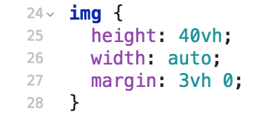
Resize Your Image I
Add a CSS rule set to style your <img>.
Set the height of your image to 40vh and the width to auto.
This line of code will create space around your image: margin: 3vh 0;
Note: This will make the Glitch fish huge. You can delete it.
Notes:
What to Say:
What to Do:

Slide 80
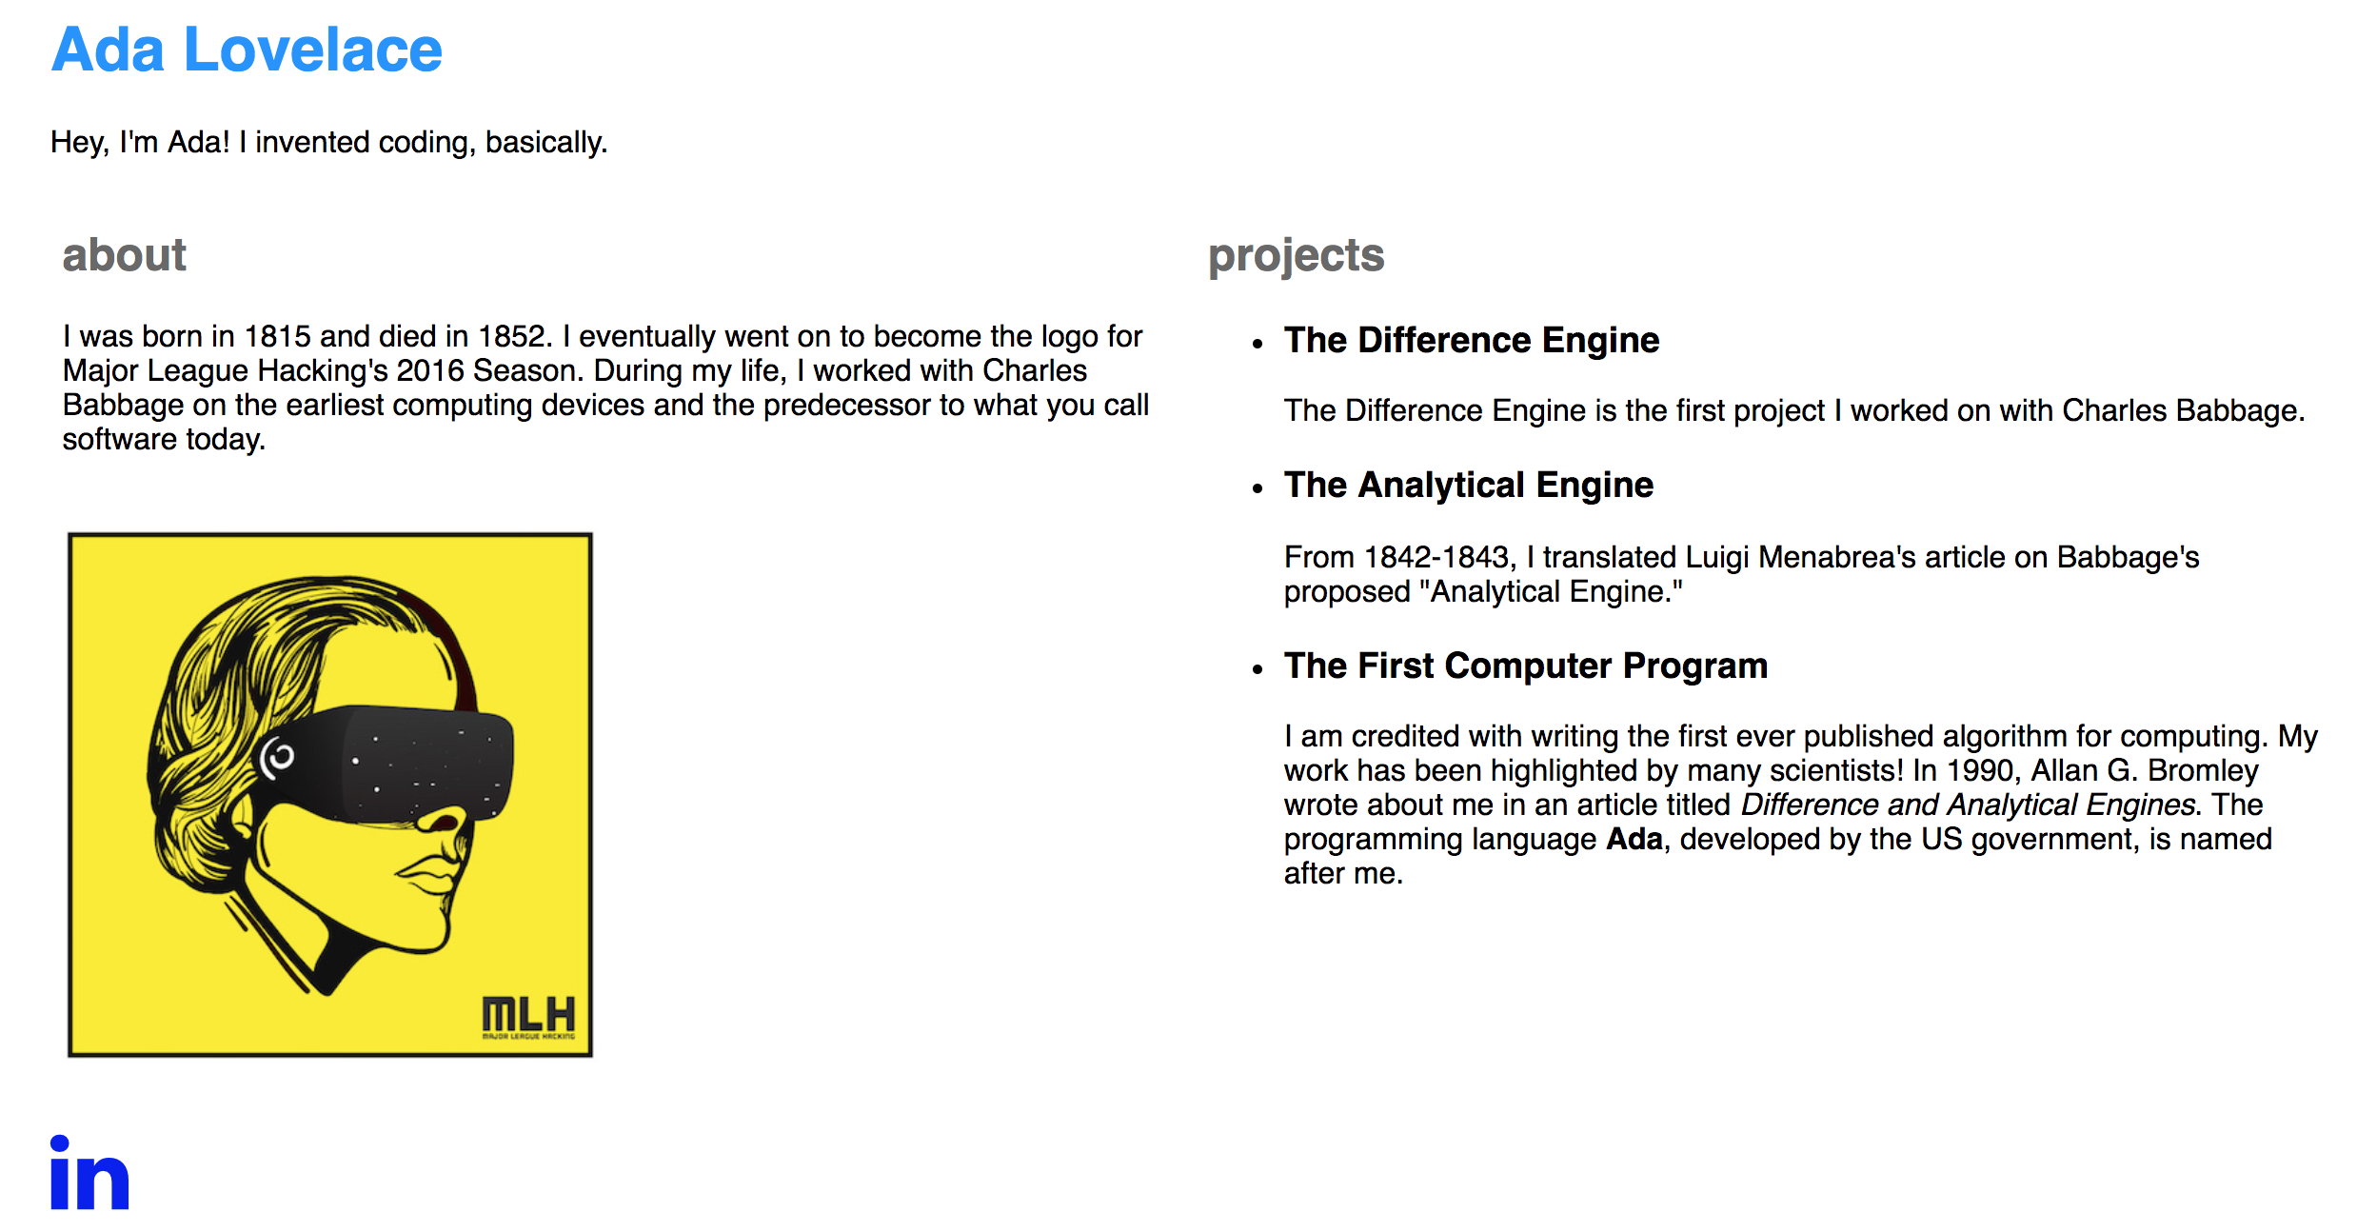
Resize Your Image II
Look at your page! That's it! You're all done!
Notes:
What to Say:
What to Do:

Slide 81
CSS Properties in This Project
There are many CSS properties. Important ones used in this project are:
display
Used to position elements. Values used in this project include: flex.
height
Used to specify the height of an element. Values used in this project vary, and are sized with vh, %, and px.
width
Used to specify the width of an element. Values used in this project vary, and are sized with vw, %, and px.
color
Used to specify the color of text. Values were declared in named css colors and hexidemical.
Notes:
What to Say:
What to Do:

Slide 82

CSS Colors
There are many ways to specify colors in CSS. Two ways that we do so in this project are:
Named colors (like blue and red) - a fun site to visit is www.colors.commutercreative.com
Hexadecimal - 6 character color codes such as #123abc
Notes:
What to Say:
What to Do:

Slide 83
Just like that, you have a deployed website where anyone on the internet can find you and your work!
In the next section, we'll cover some optional customizations that you can do now (if there's time) or whenever you want!

Slide 85
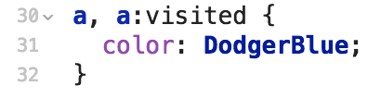
Optional Customization I
Use the CSS below to change the color of the Font Awesome contact icons you added at the bottom of the page. Add some more icons that link to your Twitter, Github, Instagram, or whatever you like!
Notes:
What to Say:
What to Do:

Slide 86
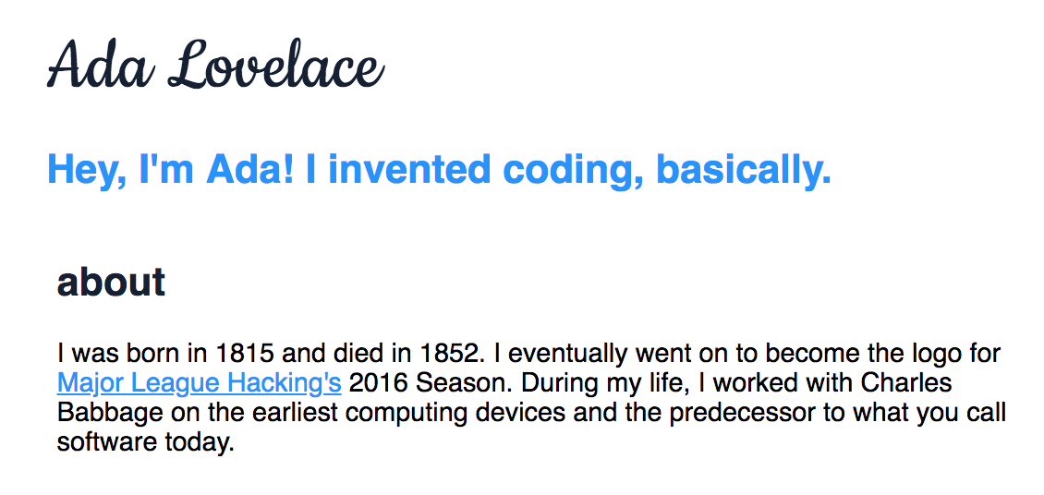
Optional Customization II
Add <a> tags around the <h3> elements that list your projects. Set the href attribute to the URL where your project is stored (Github, etc).
Notes:
What to Say:
What to Do:

Slide 87
Let’s recap quickly...
HTML creates the skeleton of every website.
1
2
CSS styles HTML elements.
3
Deploying your website makes it available for others to see by navigating to your address!
Notes:
What to Say:
Read the slide above
What to Do:

Slide 88
What did you learn today?
We created a fun quiz to test your knowledge and see what you learned from this workshop.
http://mlhlocal.host/quiz
Notes:
What to Say:
What to Do:

Slide 90
Keep Learning: Practice Problems for later.
#1: Add Fonts
Challenge: Check out fonts.google.com to add fonts to your website and learn more about them!
#2: Custom Domain
Challenge: Purchase a domain and set it up to redirect to your site.
Notes:
What to Say:
What to Do:

Slide 91

Learning shouldn’t stop when the workshop ends...
Check your email for access to:
These workshop slides
Practice problems to keep learning
Deeper dives into key topics
Instructions to join the community
More opportunities from MLH!
Notes:
What to Say:
What to Do:

Slide 92
v.0.0.1

